Slide 1
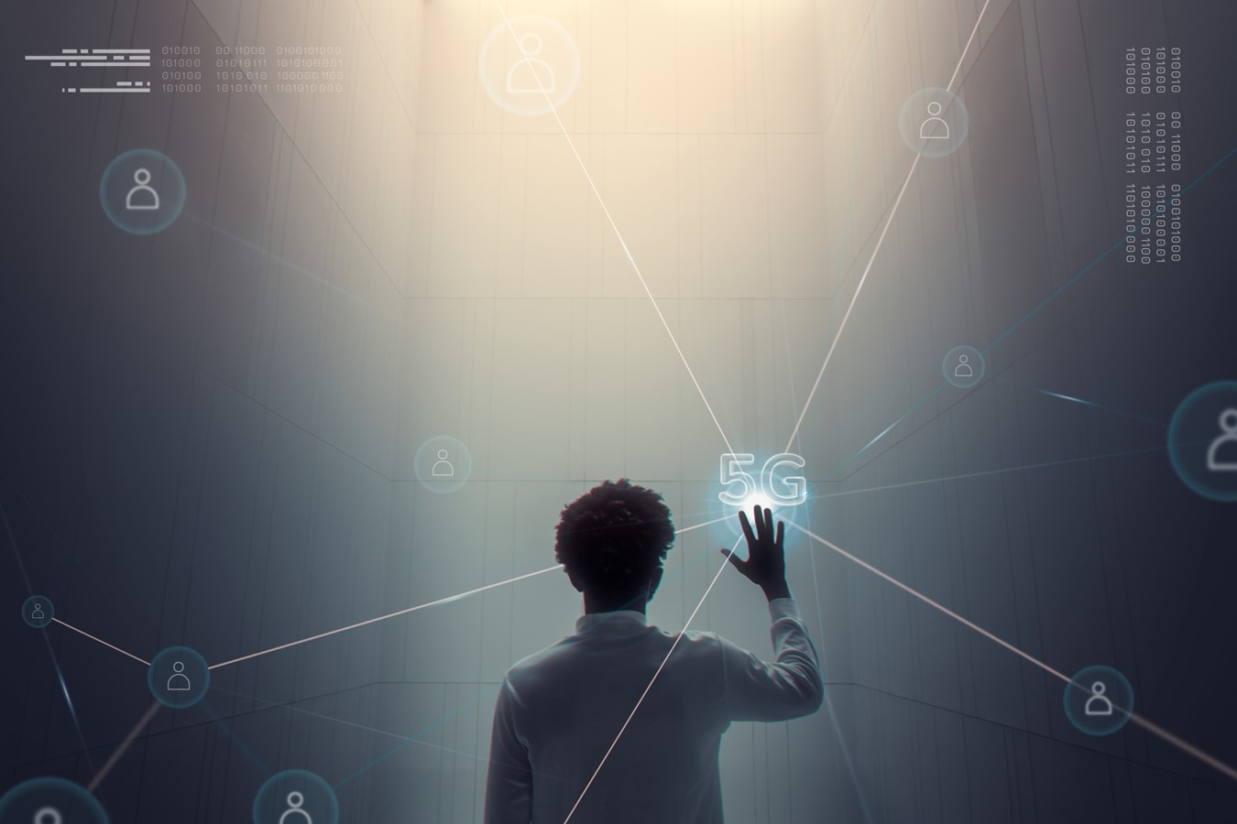
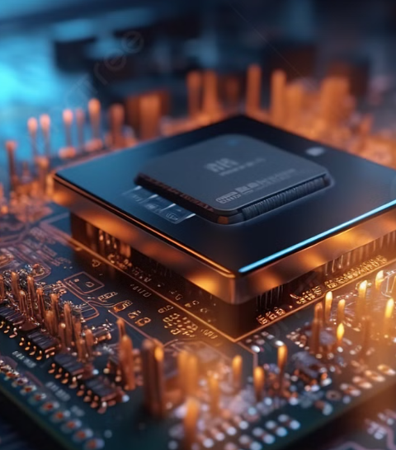
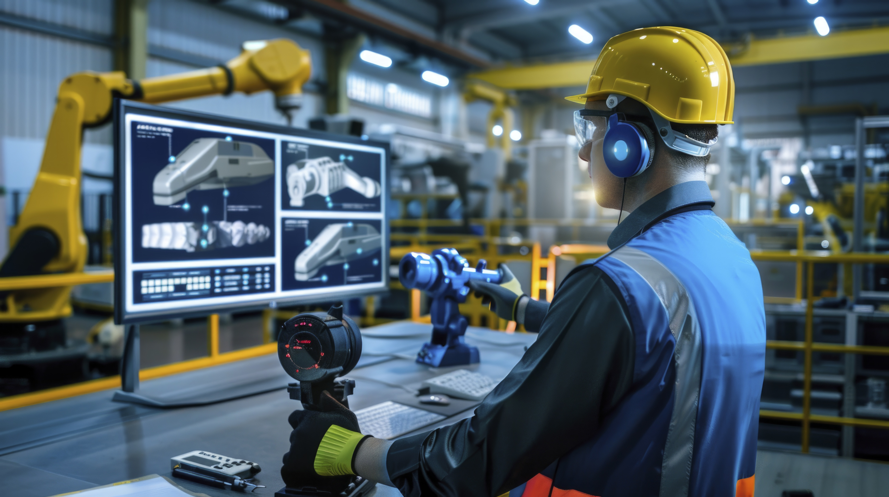

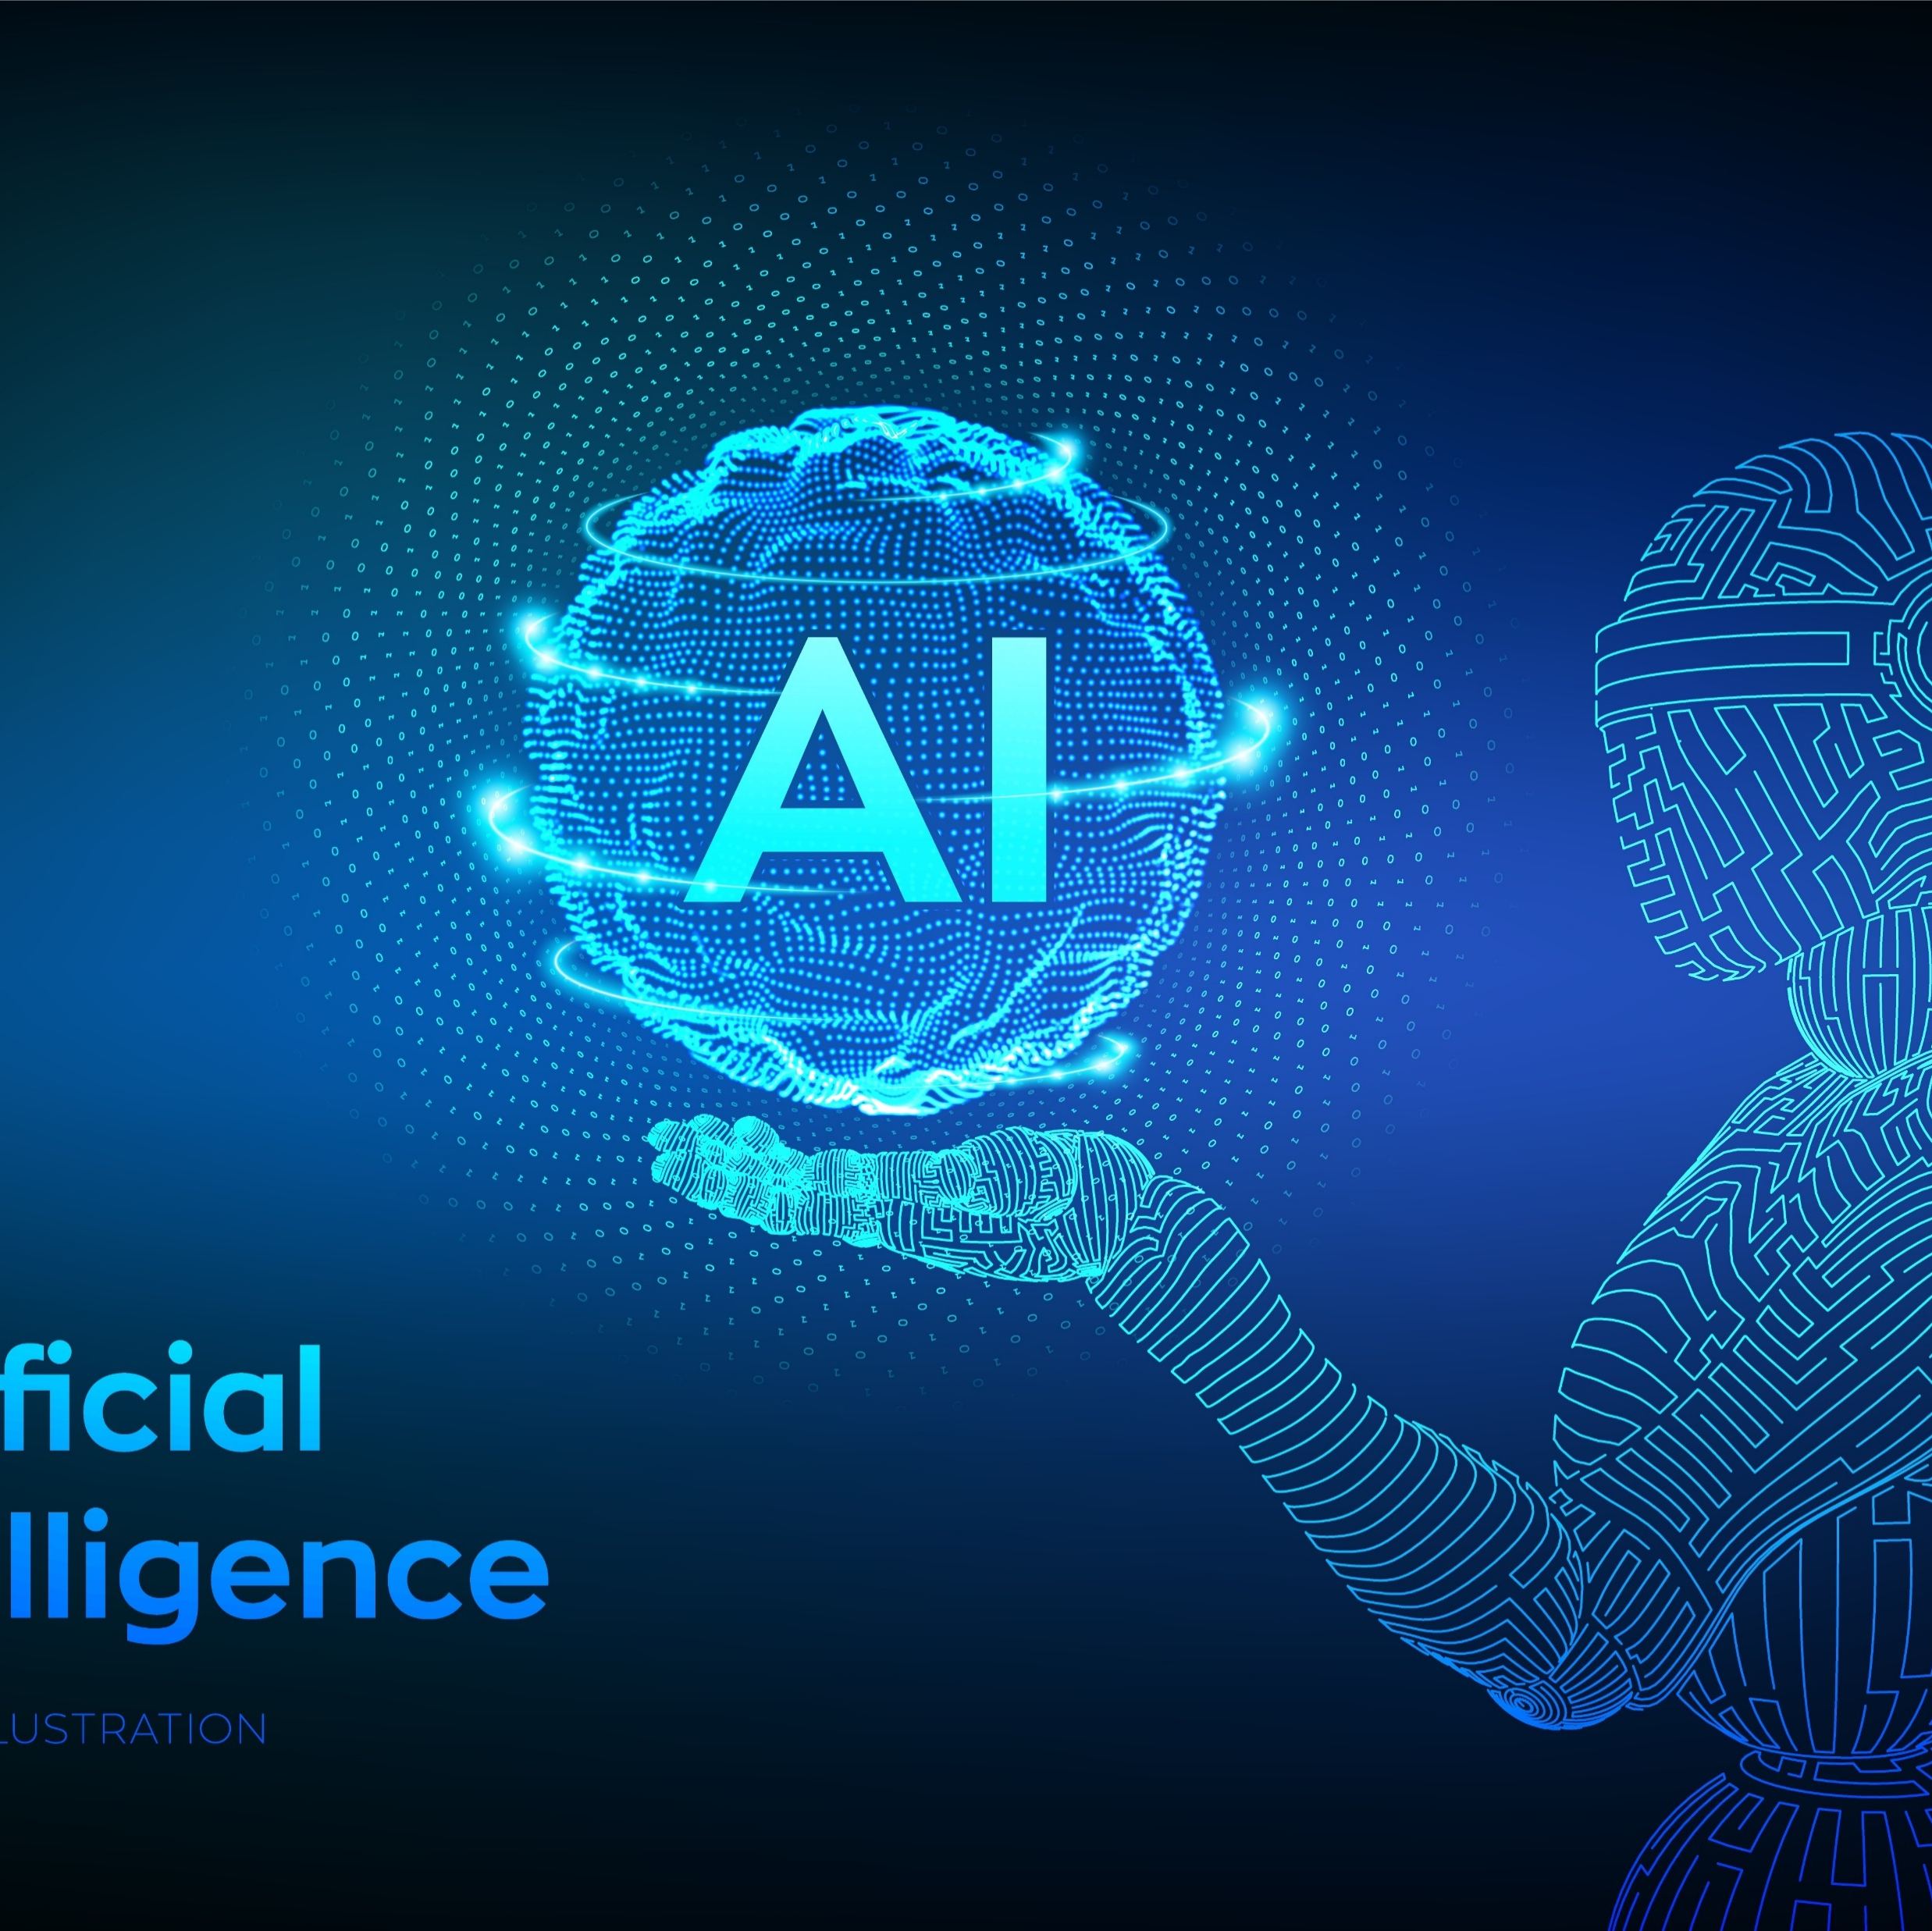
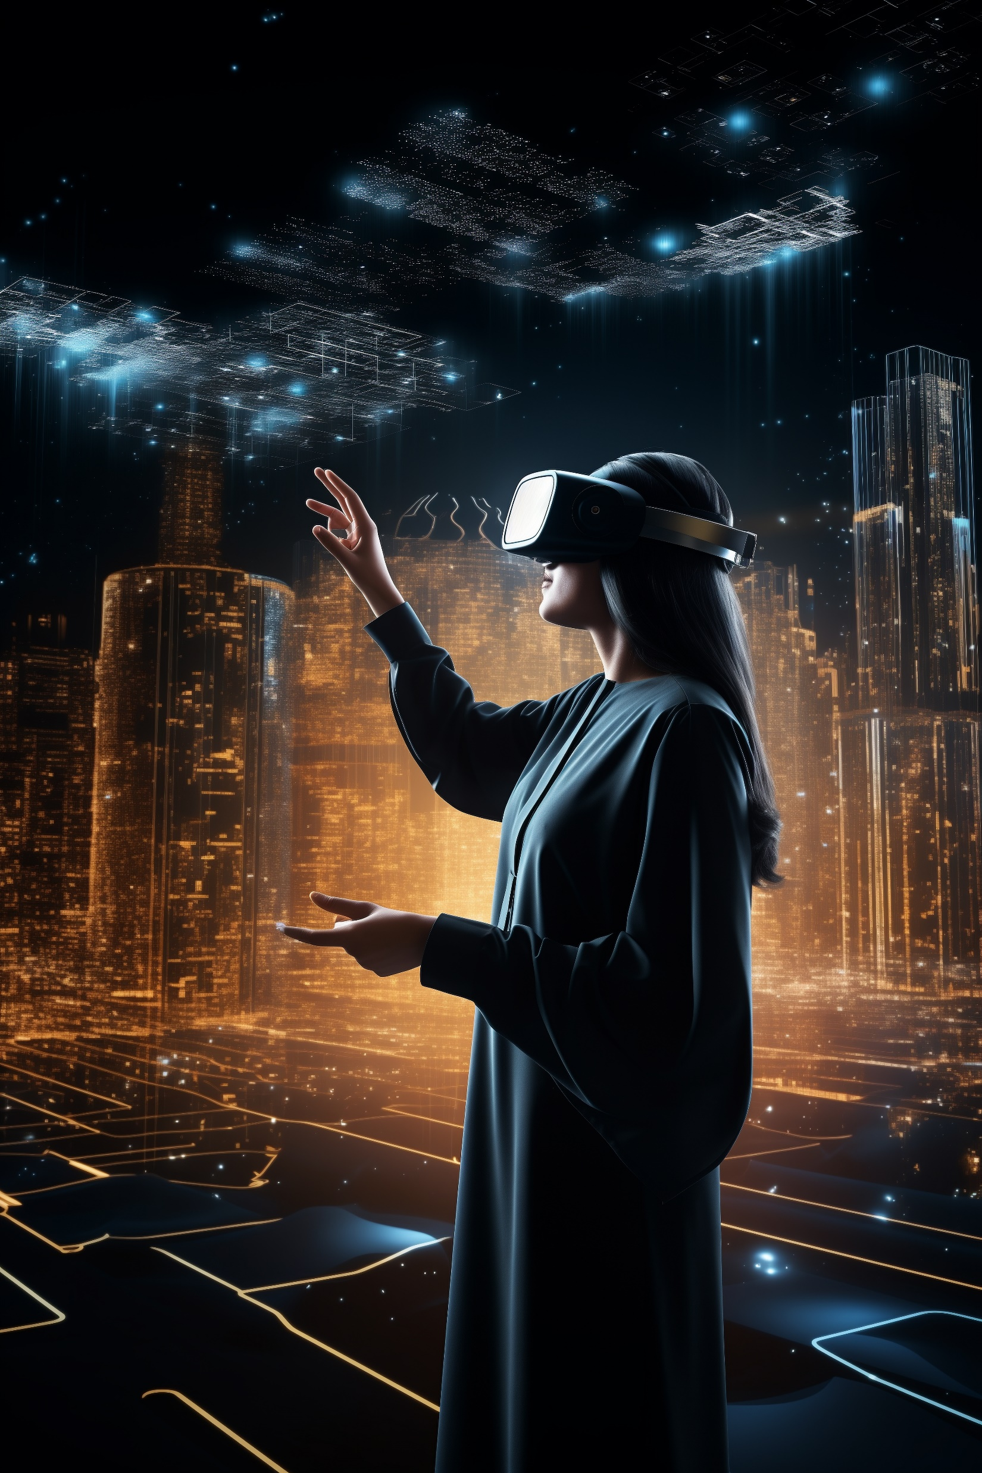

The Evolution of Technology
From the dawn of the Industrial Revolution to the cutting edge of the Digital Age, technology has transformed the world around us, ushering in unprecedented advancements that have reshaped nearly every aspect of modern life.
The Evolution of Technology
From the Industrial Revolution to the Digital Age
Advancements in Computing Power
Artificial Intelligence and Machine Learning
The Future of Technology: Trends and Predictions

Slide 2
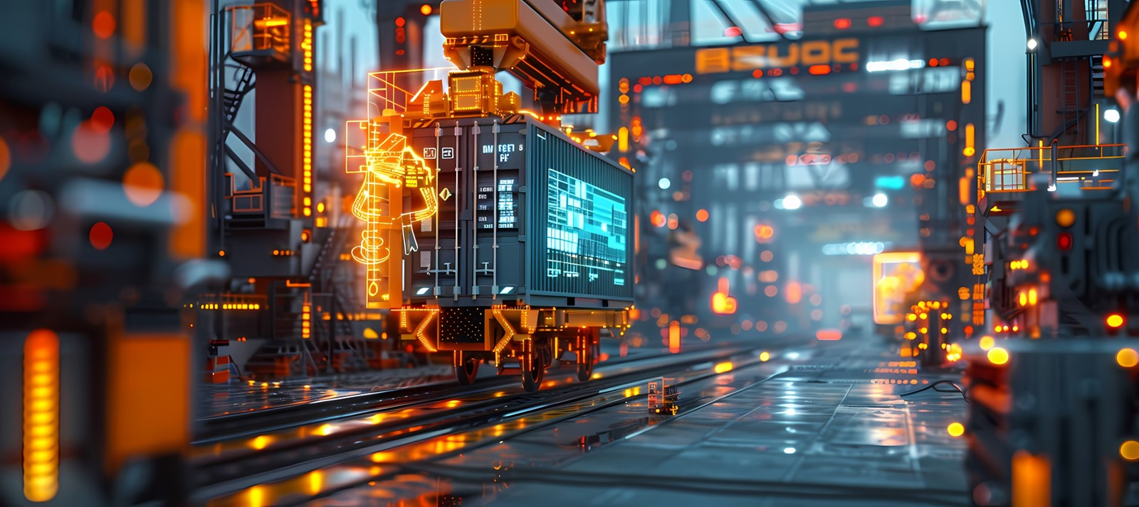

From the Industrial Revolution to the Digital Age
1- Industrial Revolution
Mechanization and mass production revolutionized manufacturing, leading to rapid economic and social change.
2- Digital Transformation
The rise of the internet, personal computers, and mobile devices has fundamentally altered how we live, work, and communicate.
3- Electronics Era
The advent of transistors, integrated circuits, and microprocessors paved the way for the digital revolution.
From the Industrial Revolution to the Digital Age
Advancements in Computing Power
Artificial Intelligence and Machine Learning
The Future of Technology: Trends and Predictions
The Evolution of Technology

Slide 3
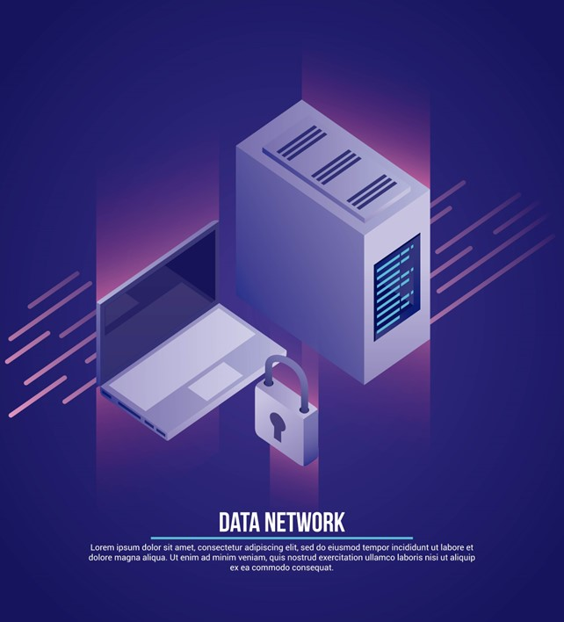
Advancements in Computing Power
Moore's Law
The exponential growth in computing power has enabled increasingly complex and powerful technology.
Edge Computin
Bringing data processing closer to the source, edge computing improves response times and reduces bandwidth requirements.
Advancements in Computing Power
Artificial Intelligence and Machine Learning
The Future of Technology: Trends and Predictions
The Evolution of Technology
From the Industrial Revolution to the Digital Age

Slide 4
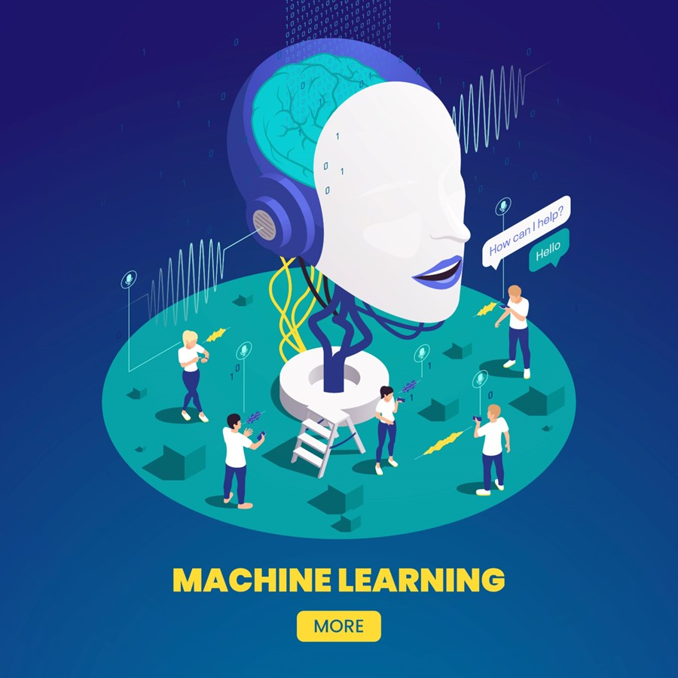

Artificial Intelligence and Machine Learning
Predictive Analytics
AI and machine learning algorithms can analyze vast datasets to identify patterns and make accurate predictions.
Automation
Intelligent systems can automate routine tasks, freeing up human labor for more complex problem-solving.
Natural Language Processing
AI can understand, interpret, and generate human language, enabling more natural human-computer interactions.
Artificial Intelligence and Machine Learning
The Future of Technology: Trends and Predictions
The Evolution of Technology
From the Industrial Revolution to the Digital Age
Advancements in Computing Power
Computer Vision
AI-powered systems can analyze and interpret visual data, with applications in areas like security and medical diagnostics.

Slide 5
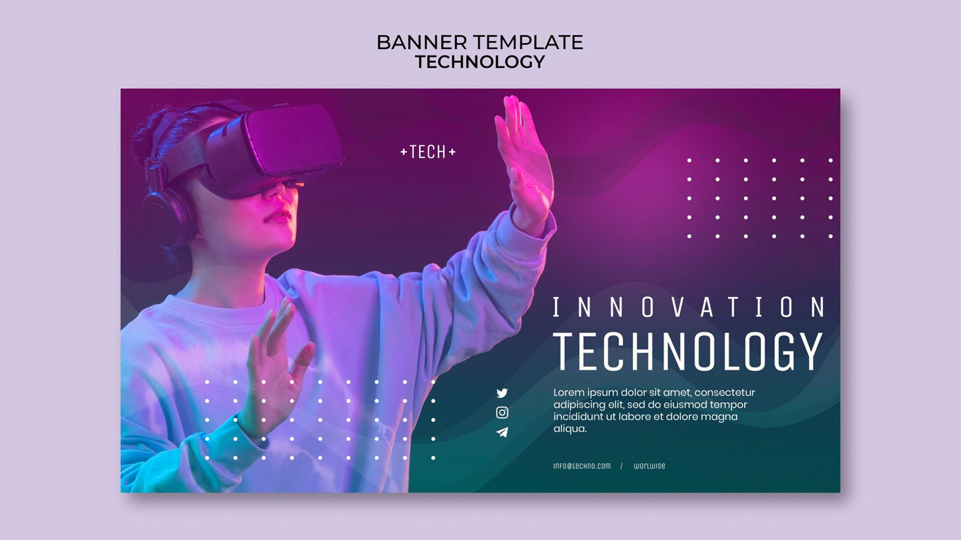
The Future of Technology: Trends and Predictions
Quantum Computing
Unlocking new frontiers in data processing and problem-solving.
Augmented Reality
Blending the digital and physical worlds for immersive experiences.
Autonomous Vehicles
Transforming transportation with self-driving cars and drones.
The Future of Technology: Trends and Predictions
The Evolution of Technology
From the Industrial Revolution to the Digital Age
Advancements in Computing Power
Artificial Intelligence and Machine Learning
Personalized Medicine
Tailoring treatments and therapies to individual genetic profiles.

